Slide 1
Azure Machine Learning
Adapted from a tutorial by Jennifer Marsman

Slide 2
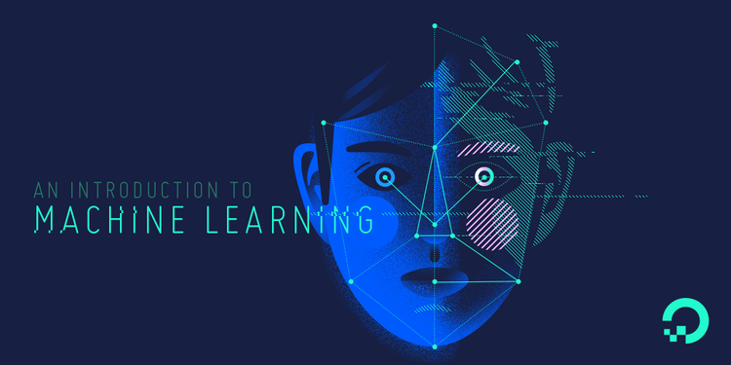
What is Machine Learning?
Notes:
ML is all about teaching computers to understand data
- We achieve this by using a ton of statistics to build models that can hopefully make accurate decisions based on past knowledge

Slide 3
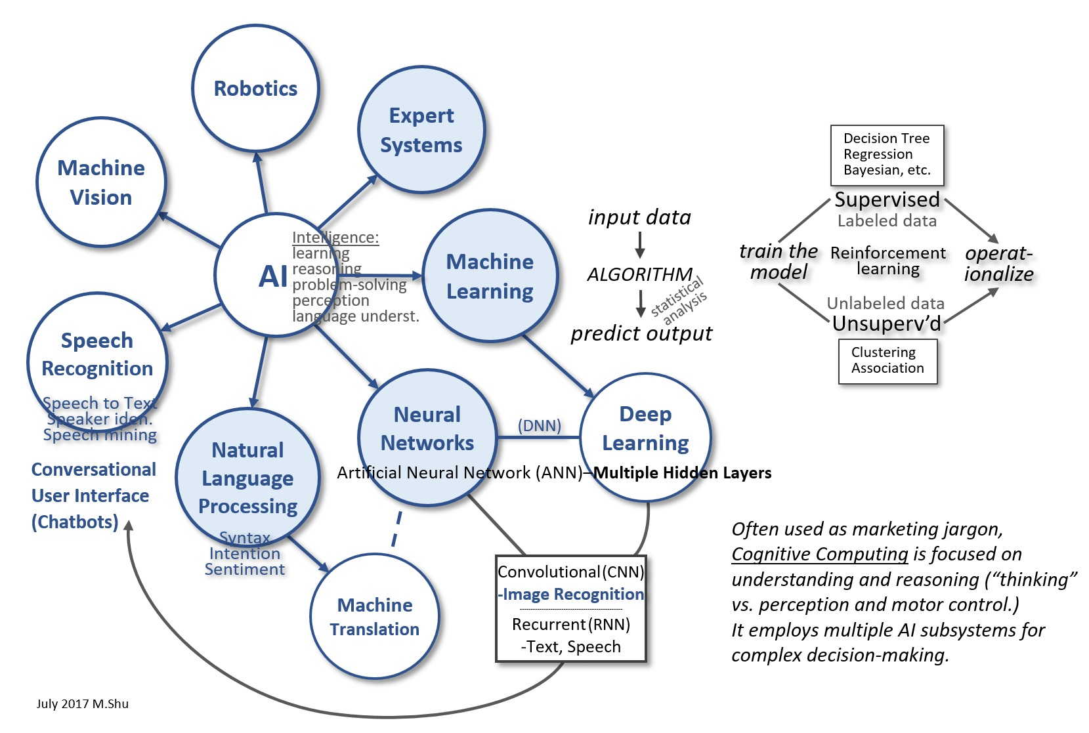
Breaking Down the Buzzwords

Slide 4
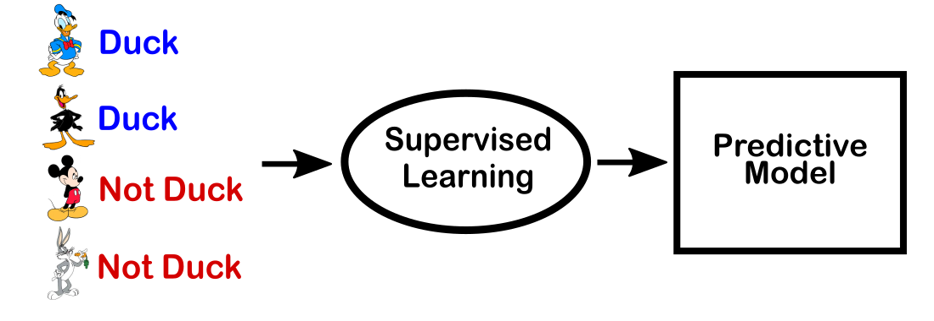
Machine Learning: Supervised Learning

Slide 5
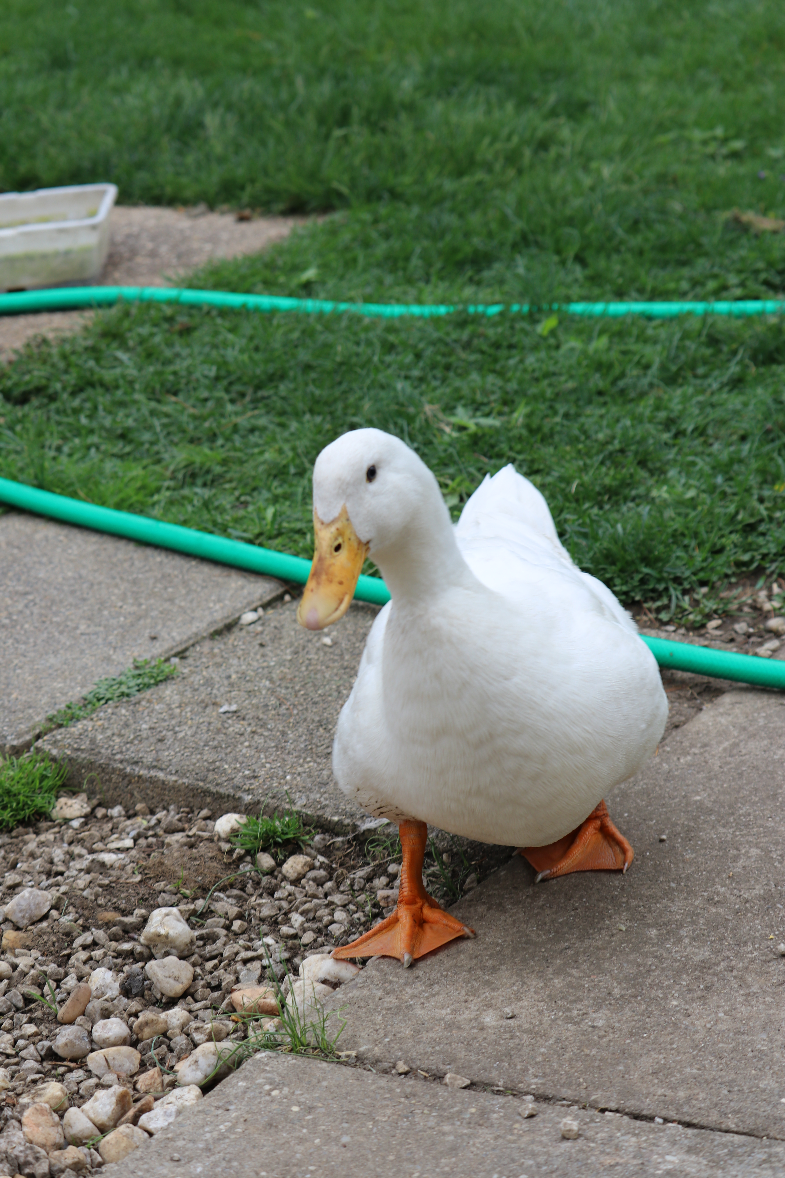
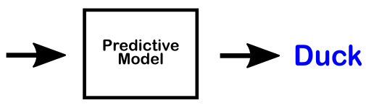
Machine Learning: Supervised Learning

Slide 6
Machine Learning Algorithms
Classification
Regression
Anomaly Detection
Clustering

Slide 7
The Power of Azure ML
25 different machine learning algorithms
Modules for importing and cleaning data
Create experiments to train and test models
Publish models as web service

Slide 8
Supervised Learning
Data set
Data cleaning
Algorithm
Split
Training data
Train model
Test data
Score model
(Another model)
Evaluate model

Slide 9
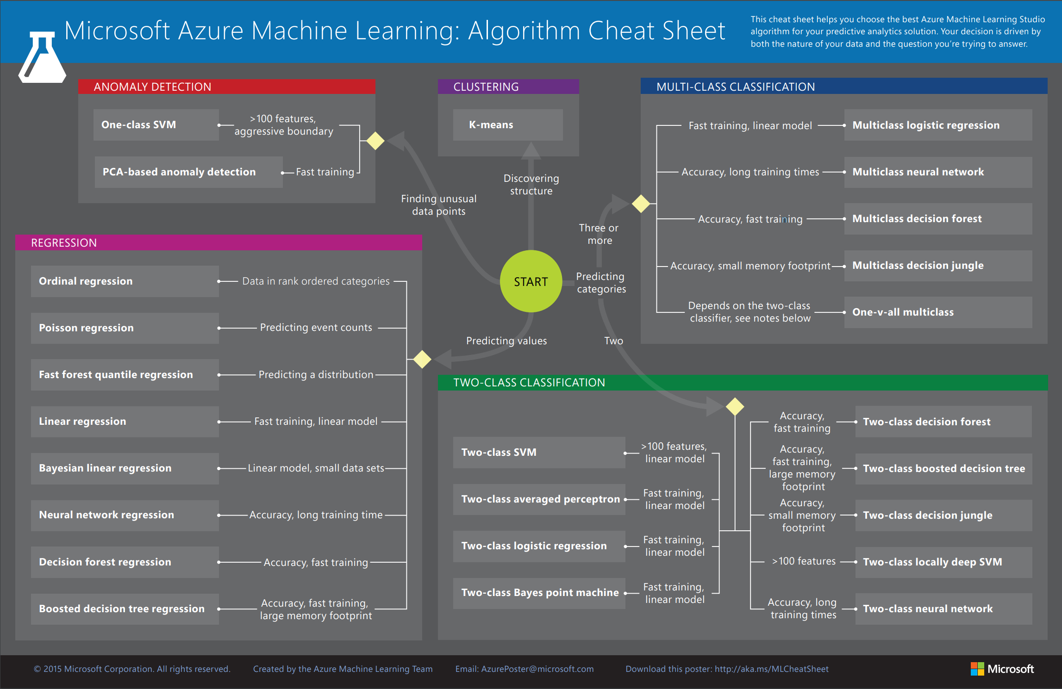

Slide 10
Resources
Download the Cheat Sheet:
http://aka.ms/AzureMachineLearningCheatSheet
Try it out!
http://studio.azureml.net
Getting started with Azure Machine Learning:
http://aka.ms/HackML

Slide 11
Demo

